Slide 1
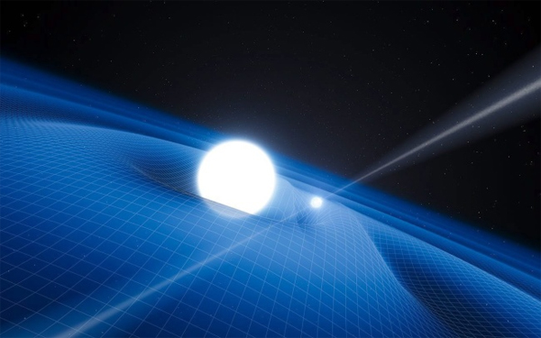



The future of the SI time unit
J. Mauricio López R.
CENTRO NACIONAL DE METROLOGÍA, CENAM
Centro Nacional de Metrología, CENAM, km 4.5 Carretera a los Cues, El Marques, Qro., www.cenan.mx

Slide 2
2015 the international year of the light

Slide 3
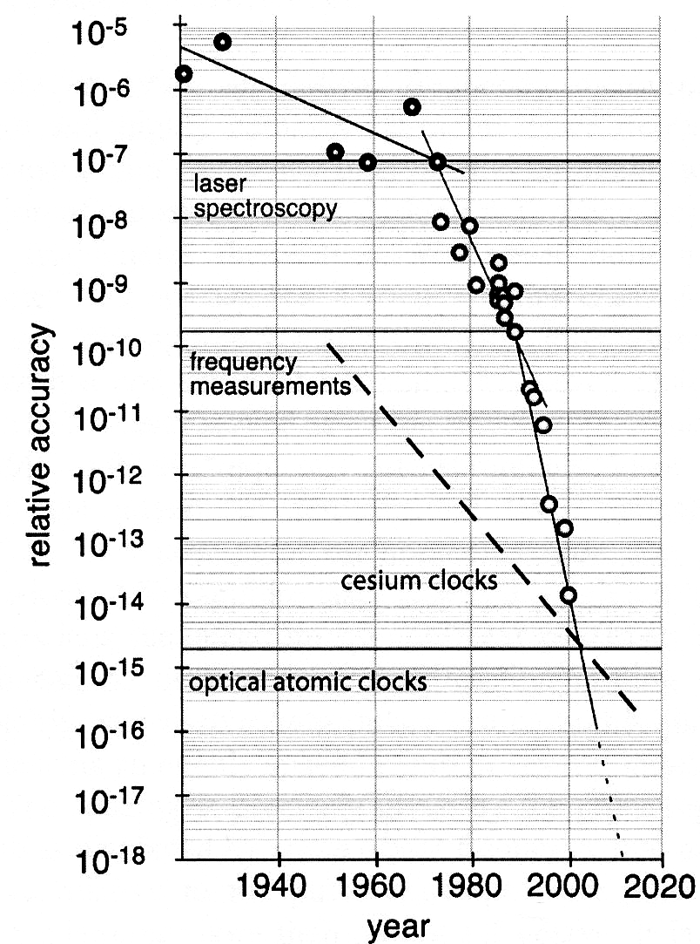
Optical spectroscopy

Slide 4
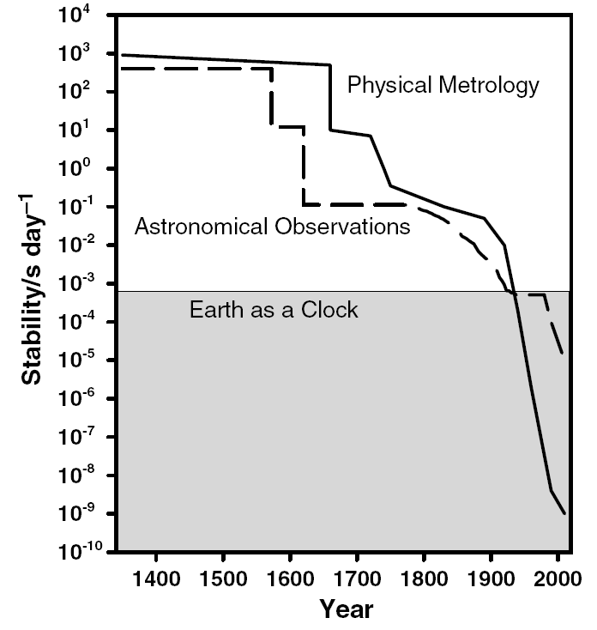
The last 600 years of time measurement
Progress at one order of magnitud per decade
Atomic clocks era

Slide 5
The last 600 years of time measurement
Progress at one order of magnitud per decade
Ultracold matter and Cs fountain clocks

Slide 6
The last 600 years of time measurement
Progress about four orders of magnitud per decade !!
Frequency combs and optical atomic clocks

Slide 7
FREQUENCY COMBS

Slide 8
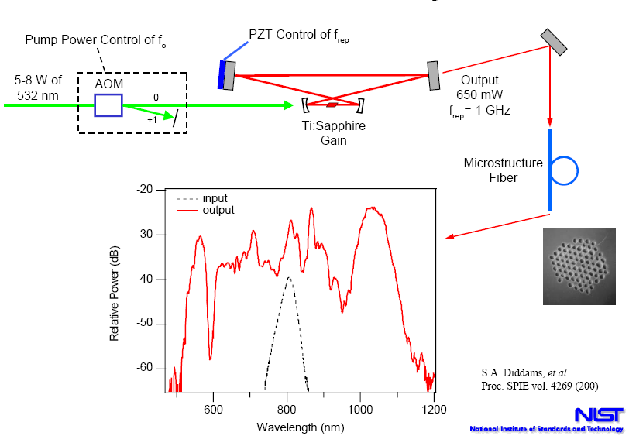
Frequency combs

Slide 9
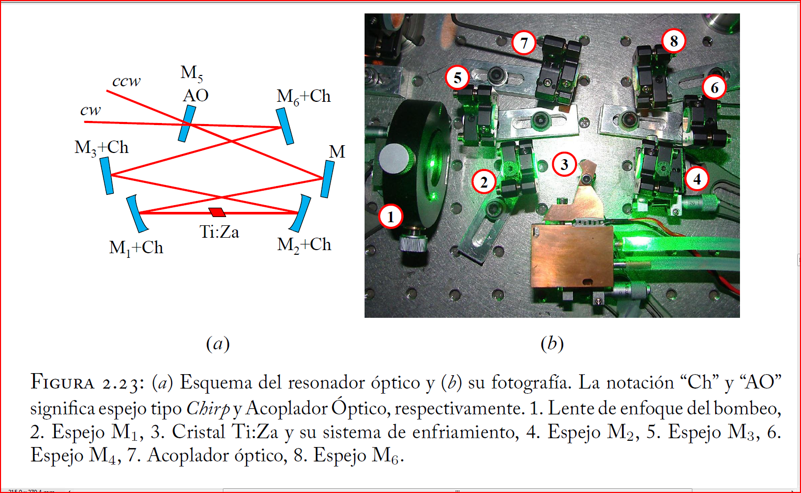
CENAM Ti:Sa Frequency Comb

Slide 10
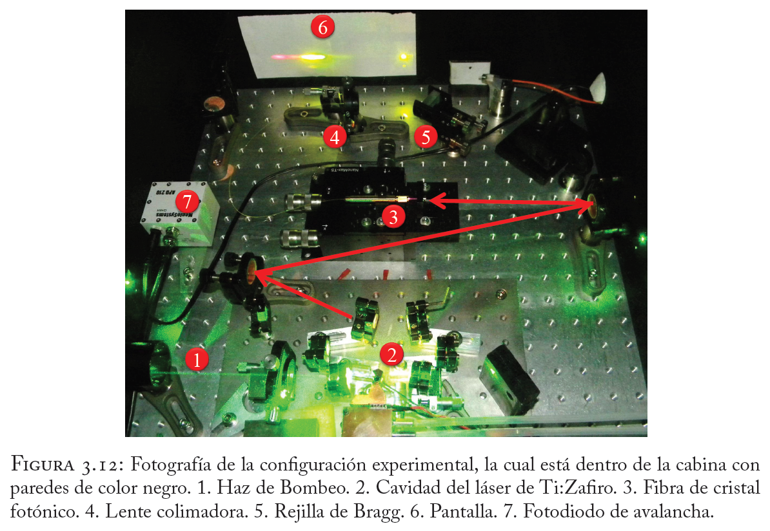
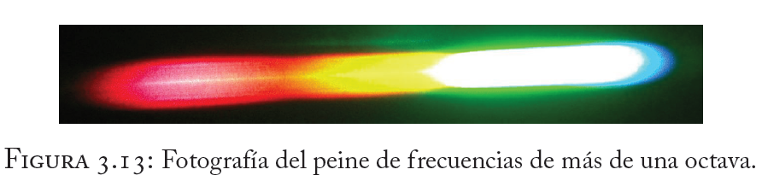
CENAM Ti:Sa Frequency Comb

Slide 11
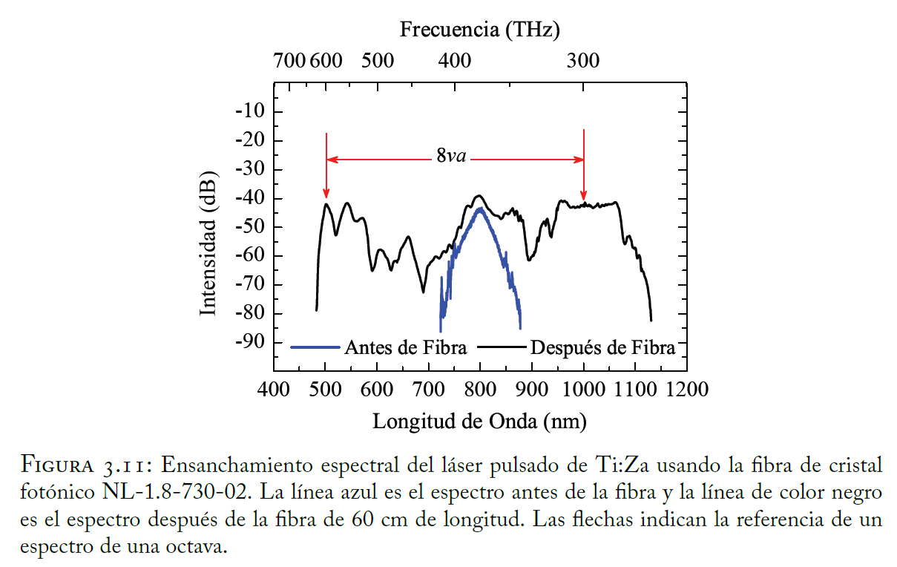
CENAM Ti:Sa Frequency Comb

Slide 12
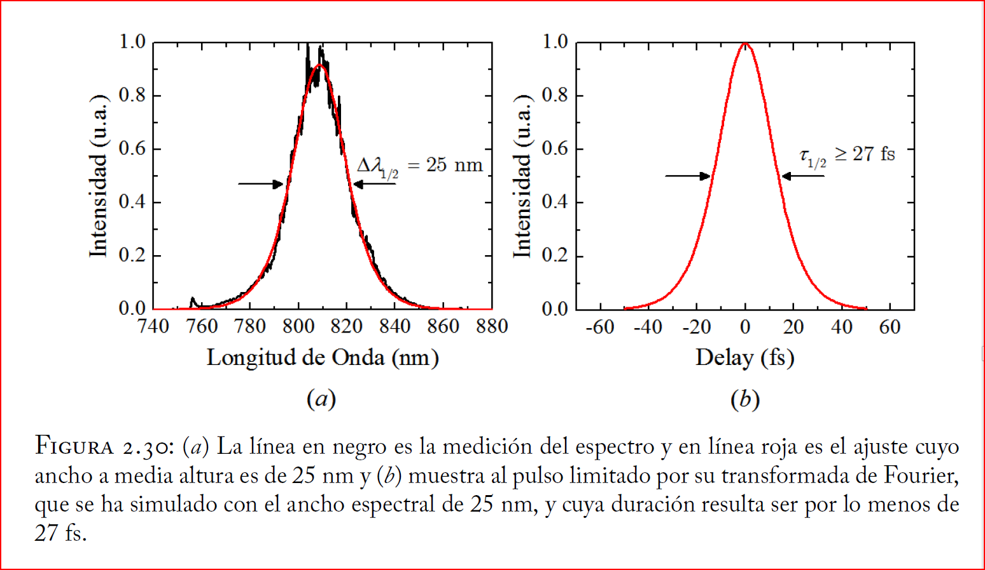
CENAM Ti:Sa Frequency Comb

Slide 13

Frequency combs
Frequency stabilization of CENAM Ti:Sa Frequency Comb
f_{o} and f_{r} : RF frequencies
Potencia de bombeo
ν _{n} : Optical frequencies
Detector de fase
$$n≈106$$
f₀
x2
0
ν

Slide 14

Frequency combs
Frequency stabilization of CENAM Ti:Sa Frequency Comb
PZT
Detector de fase
Ref.
f_{o} and f_{r} : RF frequencies
ν _{n} : Optical frequencies
$$n≈106$$
0
ν

Slide 15
ULTRA STABLE LASERS

Slide 16
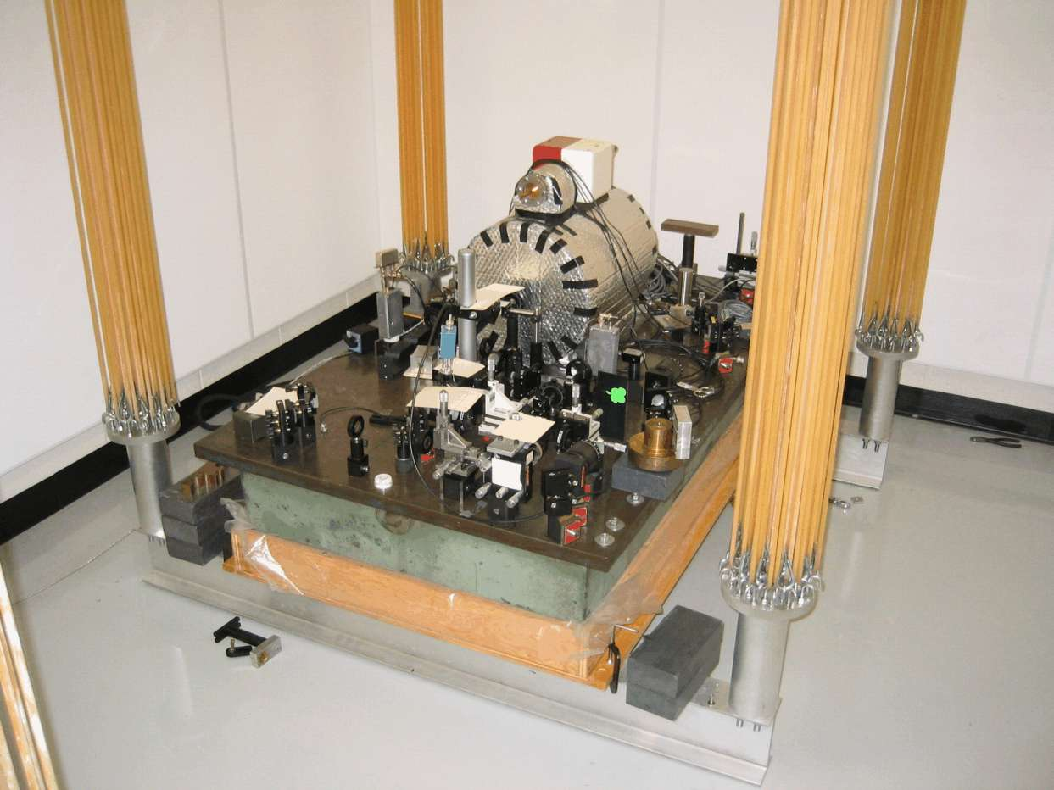
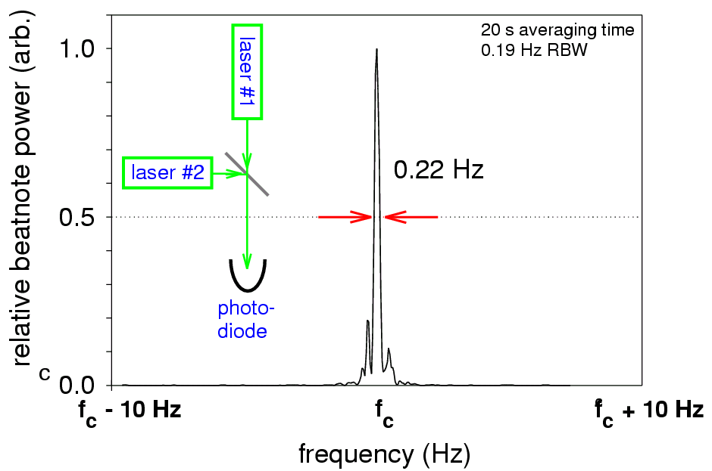
Ultra stable lasers and ULE cavities
Q = 10¹⁵
B. C. Young, F. C. Cruz, W. M. Itano, and J. C. Bergquist, Phys. Rev. Lett. 82, 3799 (1999).

Slide 17
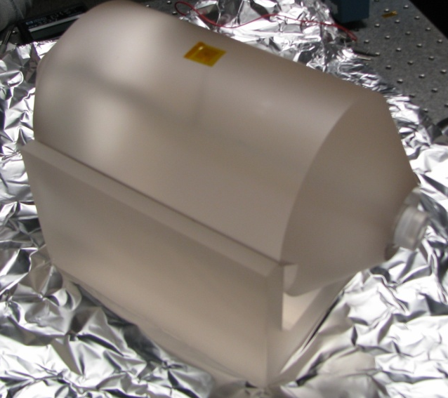
Ultra stable lasers and ULE cavities
Y. Y. Jiang, A. D. Ludlow, N. D. Lemke, R. W. Fox, J. A. Sherman, L.-S. Ma and C. W. Oates, Making optical atomic clocks more stable with 10⁻¹⁶-level laser stabilization, Nature Photonics, Vol. 5, March 2011, 158.

Slide 18
Ultra stable lasers and ULE cavities
Y. Y. Jiang, A. D. Ludlow, N. D. Lemke, R. W. Fox, J. A. Sherman, L.-S. Ma and C. W. Oates, Making optical atomic clocks more stable with 10⁻¹⁶-level laser stabilization, Nature Photonics, Vol. 5, March 2011, 158.

Slide 19
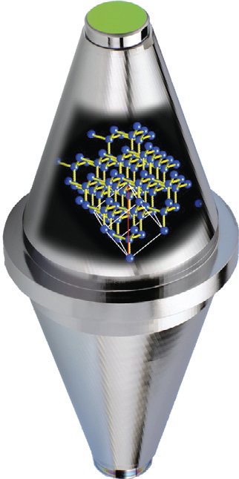
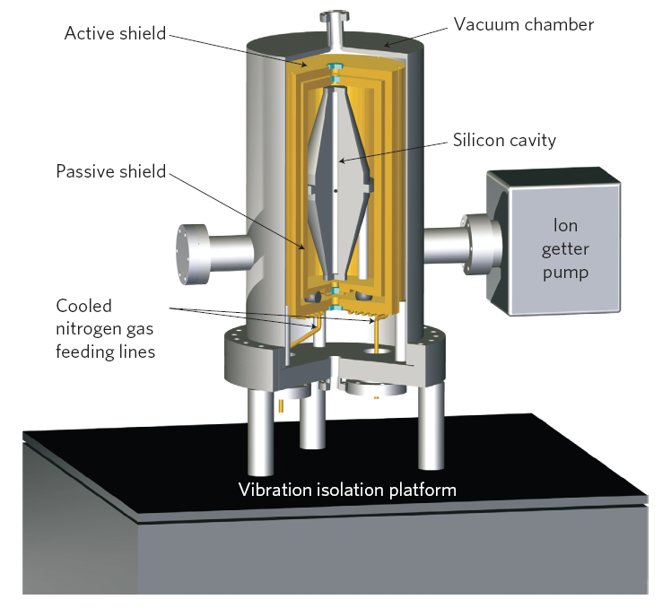
Ultra stable lasers and ULE cavities
Cryogenic ULE Cavities

Slide 20
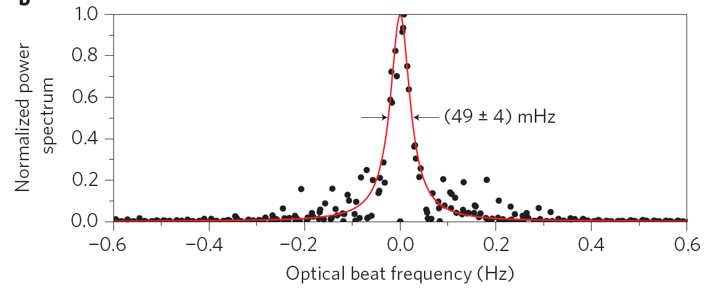
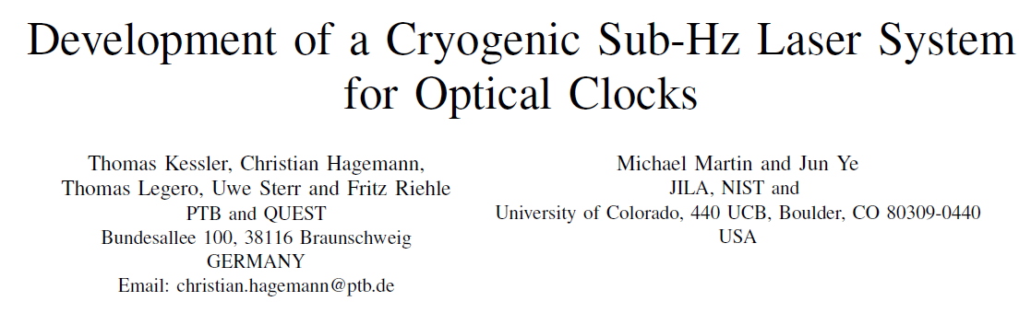
Ultra stable lasers and ULE cavities

Slide 21
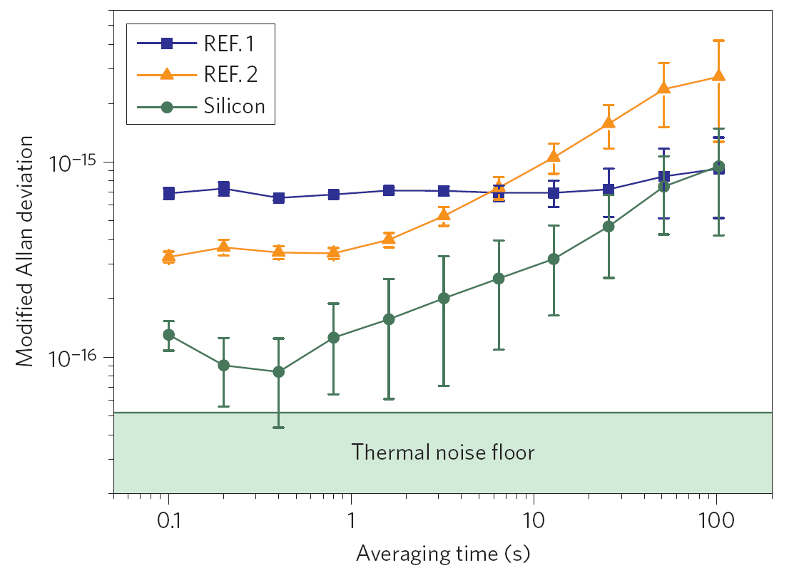
Ultra stable lasers and ULE cavities

Slide 22
Frequency combs
Ultra stable microwave frequencies from optical oscillators

Slide 23
OPTICAL TRANSITIONS

Slide 24
A significant number of optical atomic reference transitions are currently being studied, within the two generic categories of electromagnetically trapped single ions and multiple atoms trapped in optical lattices.
Research is very much a work-in-progress and covers several ion species, but is concentrated primarily on 2 atom species (⁸⁷Sr and ¹⁷¹Yb).

Slide 25
R&D on different ion and atom lattice clock species of various NMIs and research groups
JILA, University of Colorado and NIST Joint Institute for Laboratory Astrophysics; UIbk, University of Innsbruck; NICT, National Institute of Information and Communications Technology; UTokyo, University of Tokyo; U.Flo, University of Florence; U.Duess, University of Düsseldorf; U.Prov, University of Provence; ECNU, East China National University; WIPM, Wuhan Institute of Physics and Mathematics; LUH, Leibnitz University of Hanover.

Slide 26
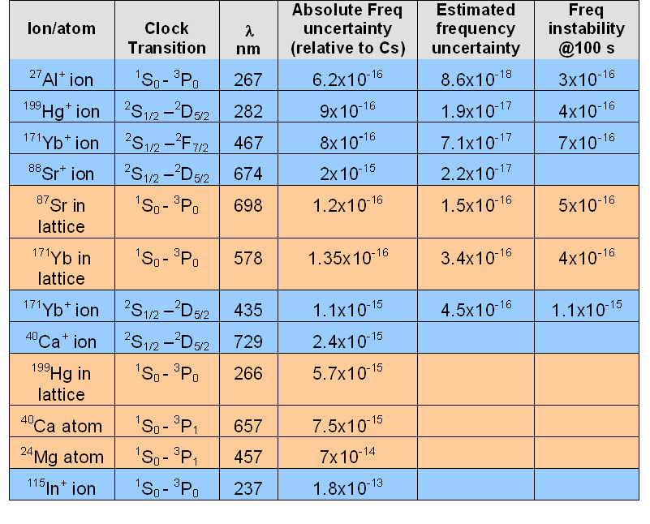
Current optical clock status for different ion and atom species
“Estimated frequency uncertainty” refers to the uncertainty relative to the reference transition of the clock.

Slide 27
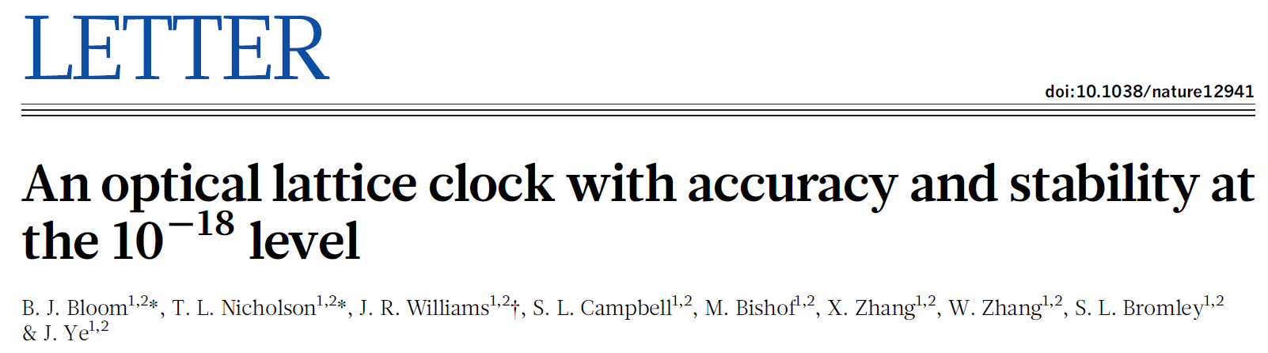
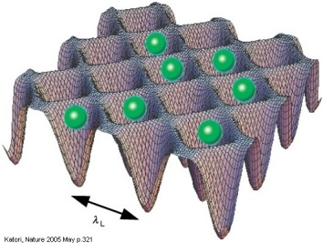
Optical atomic clocks
General Relativity at 1 cm and much more
¹⁷¹Yb Lattice Clock
³D₃
¹P₁
6s6p
³D₂
6s5d
³D₁
³P₂
³P₁
λ = 398.9 nm
τ = 5.5 ns
γ = 28.93 MHz
6s6p
³P₀
λ = 555.8 nm
τ = 850 ns
γ = 187.24 kHz
λ = 578.4 nm
τ = 21 s (¹⁷¹Yb)
24 s (¹⁷³Yb)
γ = 7.6 mHz (¹⁷¹Yb)
6.6 mHz (¹⁷³Yb)
¹S₀
6s²

Slide 28
Key elements for a new definition of the SI second
1. Ultra stable lasers
2. Frequency combs
3. Ultra narrow Optical transitions in ions or neutral atoms
4. Optical time scales

Slide 29
Key elements for a new definition of the SI second
✓
1. Ultra stable lasers
✓
2. Frequency combs
✓
3. Ultra narrow Optical transitions in ions or neutral atoms
😐
4. Optical time scales
Not yet but research in progress

Slide 30
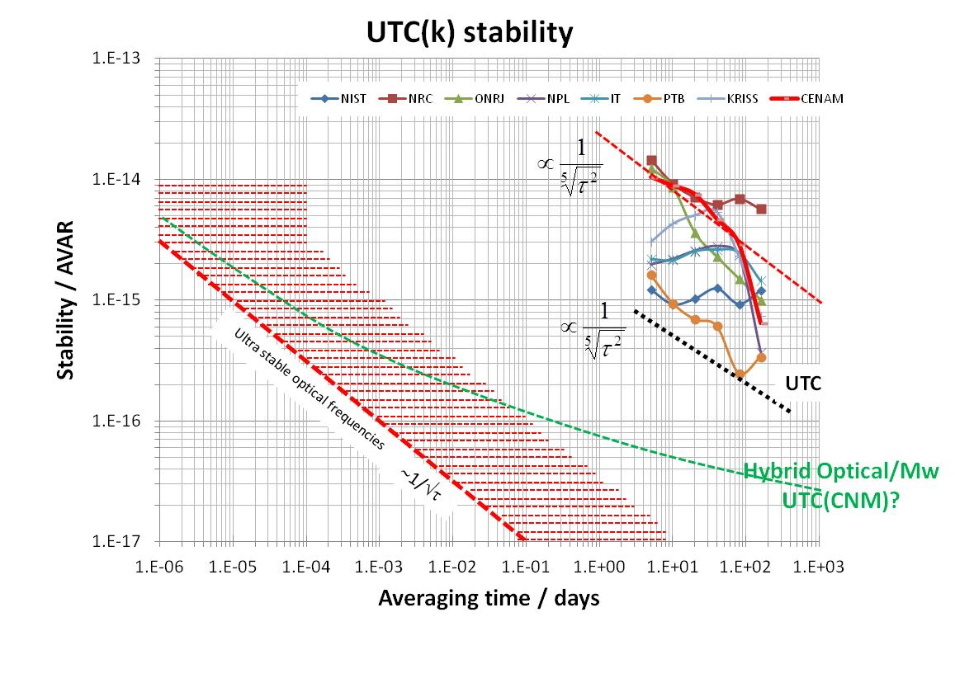
Performance of a time scale from optical clocks (?)
Time scale (?)

Slide 31
Towards a new definition of the SI second
Apart from optical frequency standards leading to a re-definition of the second, there are also possibilities of completely different approaches to a re-definition of the second. There are promising investigations of clock transitions of even higher frequencies, including nuclear transitions. There is still “a dream” of a calculable transition frequency related directly to fundamental constants such as the Rydberg constant and the speed of light. Even though the current accuracy and reproducibility of optical transitions is many orders of magnitude higher than the present best theories can deliver, these and other developments have to be followed carefully

Slide 32
The future of the SI time unit
J. Mauricio López R.
CENTRO NACIONAL DE METROLOGÍA, CENAM
THANK YOU!!
Centro Nacional de Metrología, CENAM, km 4.5 Carretera a los Cues, El Marques, Qro., www.cenan.mx

